Slide 1
CitiManager Mobile Solutions
Notes:
CitiManager Mobile Solutions

Slide 2
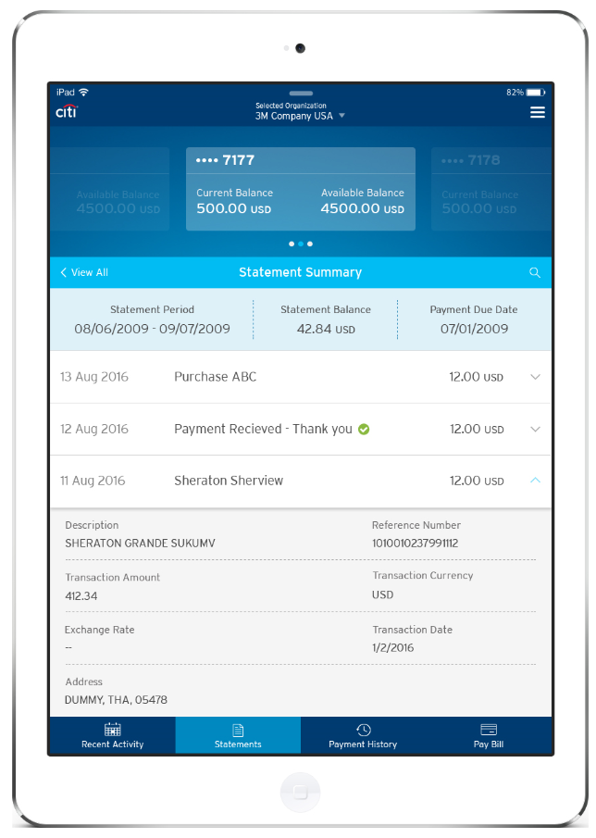
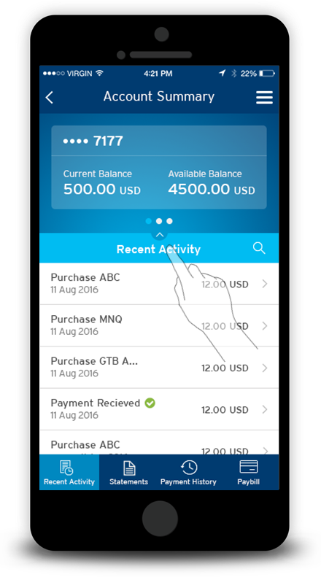


CitiManager Mobile and Tablet App
We’ve continued to enhance our CitiManager Mobile and Tablet app, that allows cardholders to easily manage their card account on the go.
Allowing Cardholders
to manage their Citi Commercial Card accounts on the go
View account summary
Access up to 6 prior statements
Review recent transactions
Review payments from the past 180 days
Make a payment
Live
2018
15
Notes:
Citi has continued to enhance our CitiManager mobile and tablet app so that cardholders can easily manage their card on-the-go. Some of the tasks a cardholder is able to do on the app is: view their account summary, access up to 6 prior statements, review recent transactions, review payments from the past 180 days, and make a payment.

Slide 3
CitiManager Mobile and Tablet App: Functionality
Coming Soon
Biometrics (All)
Receipt imaging (All)
Alerts customization (All)
Features Roadmap
Current Functionality
Cardholder login
Contact us
Language selection
Forgot user ID and password
My accounts (details on balance & credit)
New activity
Notifications
Account summary
Payment history
Statement summary
Pay bill (U.S. only)
16
Notes:
Citi’s CitiManager Mobile and Tablet app roadmap entails functionality such a biometrics, receipt imaging and customized alerts. All coming soon! Currently, cardholders have the options such as selecting a language of preference, view new activity, contact Citi and view summaries of their account and statement.

Slide 4
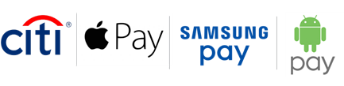
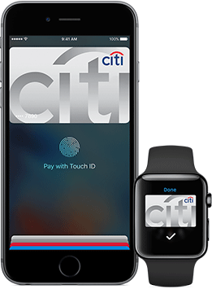
Mobile Payments
We are deploying mobile payment capabilities for US and Canada Commercial Cards, including Apple Pay, Samsung Pay, and Android Pay.
Use of a digital wallet will give cardholders an easy way to pay for official government purchases with added security. Shifting everyday expenses away from cash will benefit the cardholder and help improve compliance.
Benefits
Cardholders will be able to load their Citi Commercial Card into a mobile wallet.
Mobile payments can be used in lieu of a physical card at merchants who accept mobile payments.
Citi Commercial Card mobile payments will support Apple Pay, Samsung Pay, and Android Pay.
17
Notes:
We are deploying mobile payment capabilities for US and Canada Commercial Cards, including Apple Pay, Samsung Pay, and Android Pay.

Slide 5

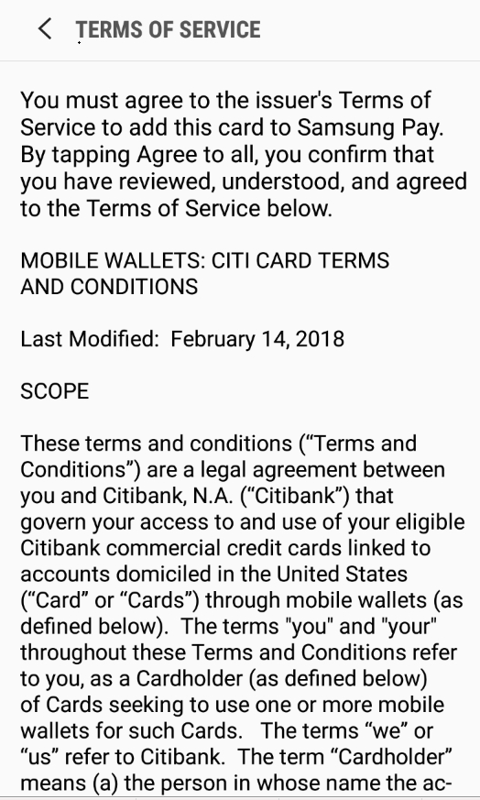
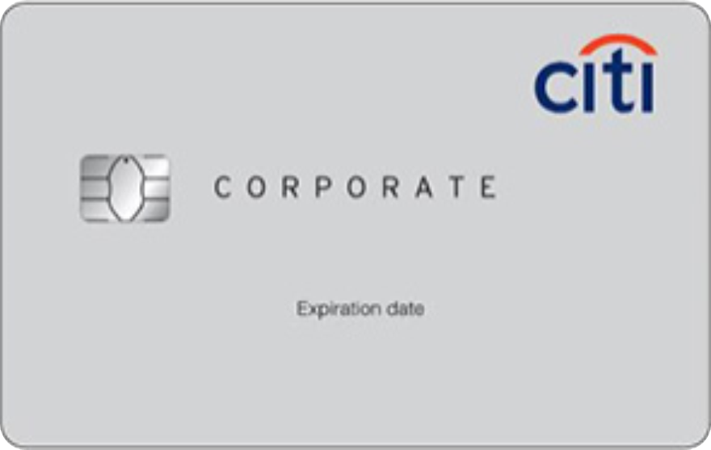
Adding a Citi Card to a Mobile Wallet
Adding a SmartPay 3 Commercial Card to your Mobile Wallet is Easy and Secure
Align card to fit in the frame
Verify card
Enter passcode
_ _ _ _ _ _
Card activated
Select an option:
Receive one-time passcode via SMS
Enter card info manually
Call bank
Agree
Press the button to add a card in your wallet app.
Follow prompts to capture relevant account info.
Read and agree to the Terms and Conditions.
Receive a one-time passcode to your registered mobile number or call Citi Servicing for verification.
Enter the passcode that is sent via SMS to you
Your card is now ready to be used
18
Notes:
Adding a SmartPay3 Commercial Card to your mobile wallet is not only easy but secure. Here are the five simple steps a cardholder needs to take to add their card to their mobile wallet.

Slide 6
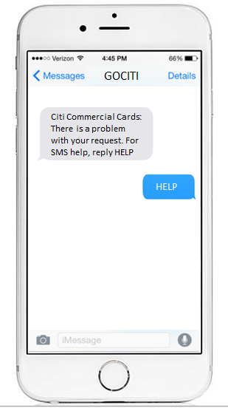
SMS and Email Alerts
Allowing Cardholders
And A/OPCs to request and receive important account information directly to their designated device for immediate action
CitiManager Alerts
Statement Ready
Payment Due
Payment Received
Payment Past Due
Replacement Card Notice
Declined Transaction
Fraud Management
Dispute Resolution
On-demand alerts
30+ Alerts in Total
>2
Million
Alerts sent per month globally
~1.23
Million
Cardholders subscribed globally
19
Notes:
Citi understands how important it is for cardholders and A/OPCs to receive important account information directly to their device which is why Citi has SMS and email alerts available. Citi sends more than 2 million alerts a month globally with 1.23 million cardholders subscribed.

